Slide 1
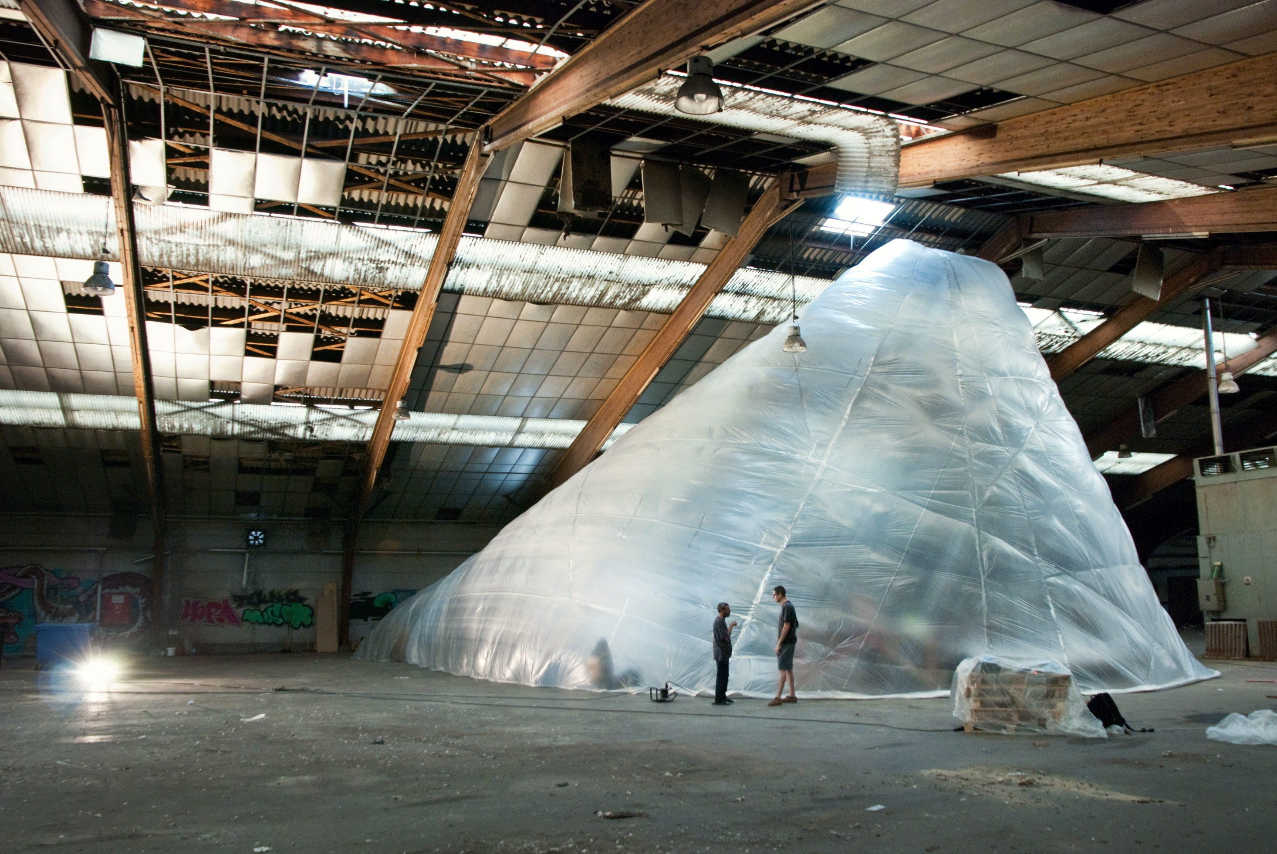
TOESTAND

Slide 2
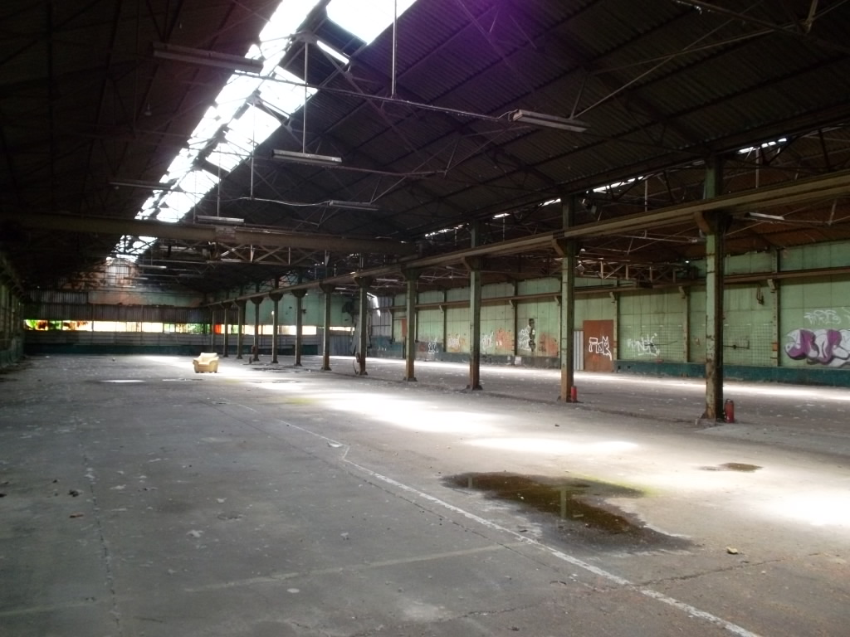
6 500 000 M²

Slide 3
ACTIVITY

Slide 4
DIVERSITY

Slide 5
INITIATIVE

Slide 6
EMPOWERMENT

Slide 7
CREATION

